Slide 1
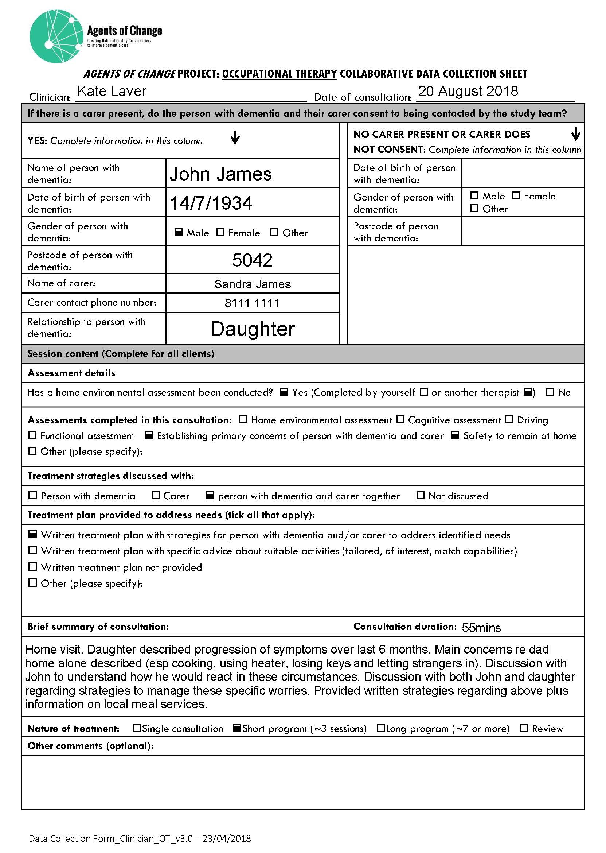
Figure B: Example of completed reporting checklist

